Slide 1
Stroke Prediciton
Springboard
Data Science Career Track
Paul Kim

Slide 2

Background
According to WHO, stroke is the second leading cause of death globally with an annual mortality rate of 5.5 million.
it also results in morbidity in 50 percent of the patients.
Understanding the reasons and causes that increase the risk of stroke is essential.

Slide 3
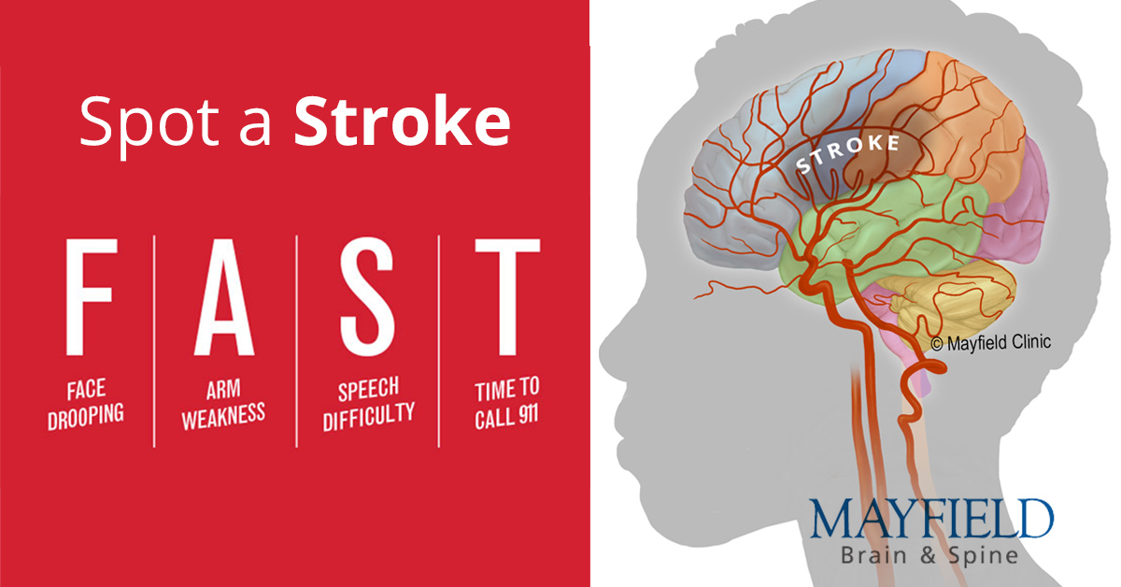
Goal
To identify people with high risk of stroke according to the features with machine learning techniques.
To develop a model that successfully detects people with high risk of stroke using their features.

Slide 4
Exploratory Data Analysis

Slide 5
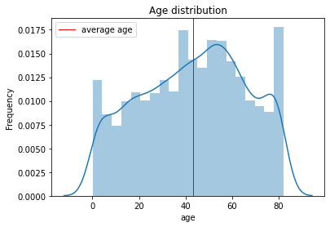
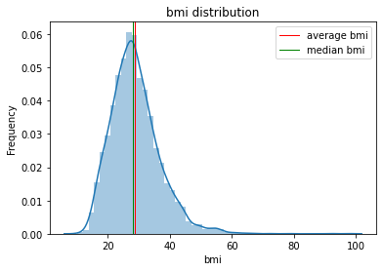
Data distribution
Age and bmi distribution of the dataset are plotted.
The dataset has an average age of 43.2 and an average bmi of 28.89

Slide 6
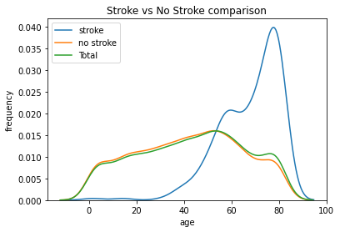
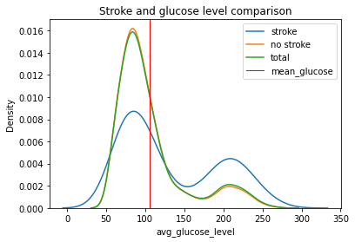
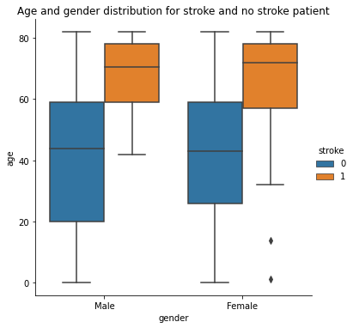
Stroke Occurrence
Stroke occurrence by age, glucose level and gender.
Stroke occurrences mostly affected by age from the visualizations.

Slide 7
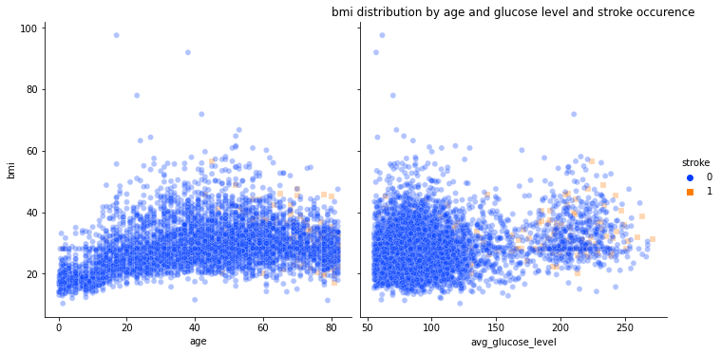
Correlation
Correlation between age and bmi is not strong, and glucose level and bmi correlation does not exist.
Higher glucose level and older patients have higher risk of stroke.

Slide 8
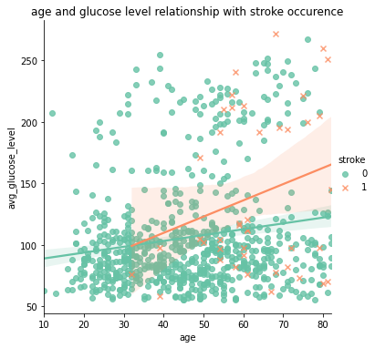
Patients with stroke have stronger positive correlation between age and glucose level compare to patients without stroke.

Slide 9
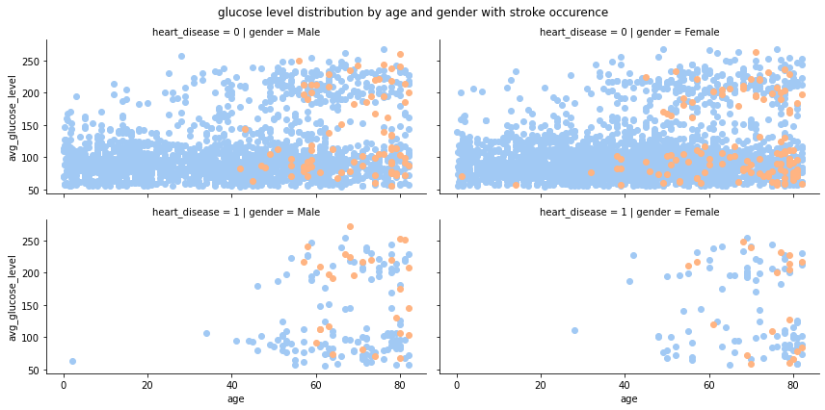
Heart disease patients are mostly older than 50 years old.
Heart disease and stroke do not have strong relationship between them.

Slide 10
Modelling

Slide 11
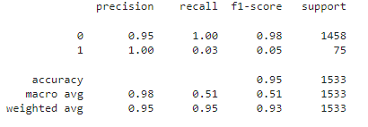
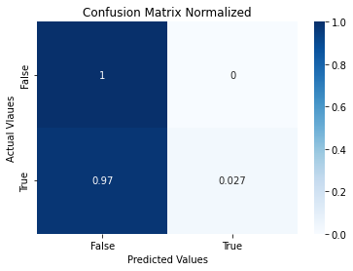
Baseline Modelling
Encountered imbalance classification with baseline model.
Performed poorly on predicting true values.

Slide 12
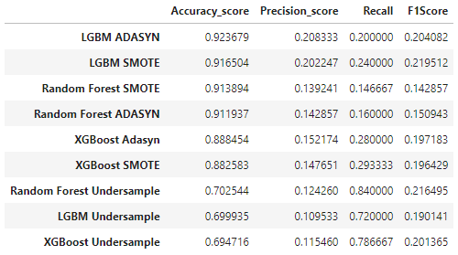
Models before tuning
Models’ performances were evaluated.
Models with SMOTE (Oversampling Method) performed the best
Hyperparameter tuning conducted afterwards.

Slide 13
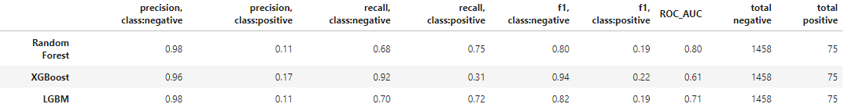
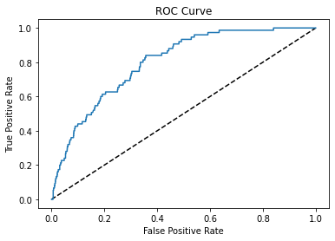
Tuned Model
Random Forest Classifier Model performed the best in terms of recall score for positive class
Random Forest model also had largest ROC-AUC compare to other models.

Slide 14
Conclusion
The goal of this model is to predict the stroke cases and having a large number of false negative would completely fail the purpose.
Even if the model has high false positive, it is better to have lower false negative.
The Random Forest Classifier algorithm model would be appropriate since it performs the best out of 3 models in terms of recall score for positive class.

